Slide 1

MA2012 INTRODUCTION TO MECHATRONICS SYSTEMS DESIGN
Lecture 2
Prof Ang Wei Tech
College of Engineering
School of Mechanical and Aerospace Engineering

Slide 2
RECAP
What is a Mechatronics system?
Systems – definition and example
Mechatronics System Components
Mechatronics System Examples
Mechatronics System Design Steps

Slide 3
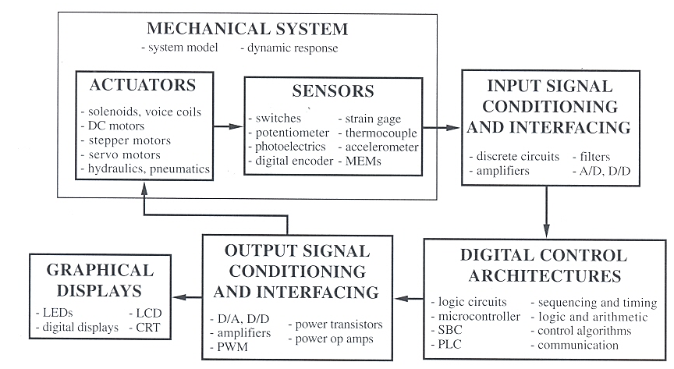
MECHATRONIC SYSTEM COMPONENTS

Slide 4
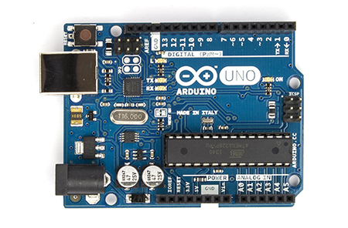
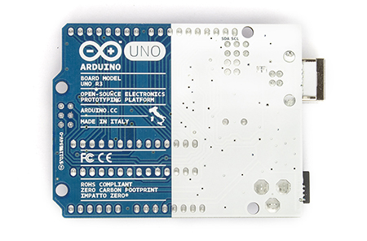
MICROCONTROLLER
Microcontroller (MCU) is a microcomputer (CPU + Memory + I/O) in a integrated circuit chip
In this course, we use Arduino UNO

Slide 5
ARDUINO UNO MCU SPECIFICATIONS
Microcontroller | ATmega328
Digital I/O | 14 (of which 6 provide PWM output)
Analog Input | 6
Microprocessor Speed | 16 MHz
Memory: Flash SRAM EEPROM | 32 kB 2KB 1KB
Voltage: Operating Input | 5 V 7-12 V
Physical: Dimension Weight | 68.6 x 53.4 mm 25 g

Slide 6

ARDUINO UNO COMPONENTS
ATMega328 MCU

Slide 7
ARDUINO UNO MCU
Arduino Uno is a MCU, ATmega328 is also a MCU. What happened?
Arduino uses OEM (Original Equipment Manufacturer) microcontrollers and reengineers them into different architectures (i.e. memory, bus, I/O configuration, communication integrated chips (IC), etc.) for their own customized needs

Slide 8
NUMBER OF BITS
ATmega328 is a 8-bit MCU, i.e. Arduino Uno is a 8-bit MCU
Amount of data processed at one time = 8 bits = 1 byte
16 -bit MCU would process twice amount of data
32-bit ≡ 4x; 64-bit ≡ 8x
N-bit MCU has
N-bit word (variable) size, 2^{N} different possible values
N-bit instruction size, 2^{N} number of instructions / commands

Slide 9
PROGRAM EXECUTION SPEED
Arduino Uno microprocessor speed = 16 MHz
Program Execution Speed ≠ Driven Clock Speed (Microprocessor speed)
Microprocessor runs at a higher frequency than all other components, i.e. memory, bus, I/O, etc.
Program execution speed is heavily influenced by the slowest component(s)

Slide 10
COMPUTER GENERAL KNOWLEDGE QUIZ #1
What is the processor speed of your mobile phone CPU?
How many bits does the CPU have?
How about your laptop?

Slide 11
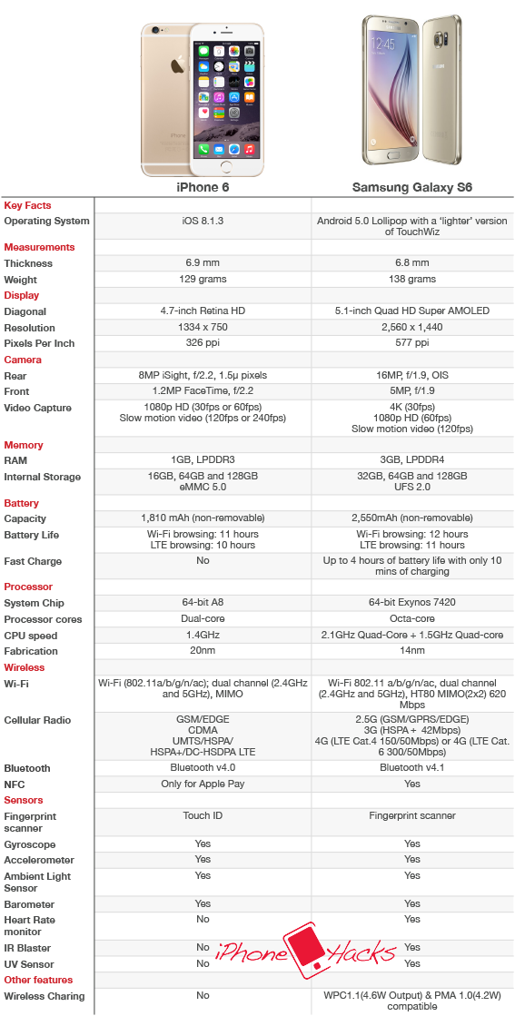
MOBILE PHONE SPECIFICATIONS

Slide 12

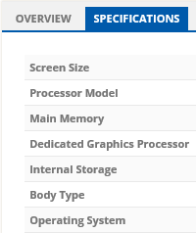
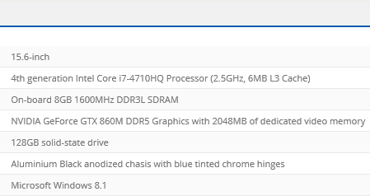
LAPTOP SPECIFICATIONS

Slide 13
MEMORY
A memory cell is a device or circuit used to store a single bit (“1” or “0”)
A memory word is a group of memory cells
Internal memory (a.k.a. main or working memory)
Highest speed memory
Function
Store programs for sequenced execution
Store data for output at required time
Types of memory
RAM, ROM, EEPROM, Flash

Slide 14
RANDOM ACCESS MEMORY (RAM)
Any memory device that can go directly to an address without having to sequence through other locations
Volatile
Data gone when system loses power
Variables and I/O data are stored in RAM when arithmetic & logic operations are performed on them
RAM in Arduino Uno
Capacity = 2 kB
Type: Static RAM

Slide 15
STATIC RAM VS DYNAMIC RAM
SRAM
Semiconductor RAM device that consists essentially of flip-flop registers and the necessary circuitry for decoding
Information will remain valid as long as power is on
Advantages
Access speed, circuitry simplicity
dRAM
Memory devices that store binary data by charging the gate capacitances of Metal Oxide Semiconductor (MOS) transistors
Refreshing or periodically recharging (every ~4 ms) is required
Advantages
Cost, density, low power consumption

Slide 16
READ-ONLY MEMORY (ROM)
Semiconductor memory device design primarily for having data read from them
Data cannot be changed during operation
Non-volatile
Data is not lost when power is off
Program vs write
Programming refers to a procedure of putting data into memory for nonvolatile storage
Writing means an instruction that send data to an address in RAM or external storage

Slide 17
ELECTRICALLY ERASABLE PROGRAMMABLE ROM (EEPROM)
Erasable programmable rom (eprom)
Semiconductor ROM device with which the user can erase and reprogram the contents of memory as many times as desired
Exposure to UV lights erases information on the entire memory chip (all 1’s)
eEprom
Semiconductor ROM device with which the user can erase and reprogram individual locations by the application of appropriate voltage levels and pulse durations
EEPROM in Arduino Uno = 1 kB

Slide 18
FLASH MEMORY
A type of EEPROM, i.e. non-volatile
Erasable and programmable a block of data instead of a bit
Can be used as ROM (Flash Bios), Disk Drive (USB drive, SD card, Solid State Drive, etc.) or RAM (Flash RAM)
Advantages vs
EEPROM – Versatility, can be used as RAM
RAM – As fast as DRAM, non-volatile
Disk Drive – Speed, no moving parts (solid state)
Flash Memory in Arduino Uno = 32 kB

Slide 19
ARDUINO UNO MEMORY SUMMARY
RAM (2 kB)
To store run-time data
EEPROM (1 kB)
To store settings and fixed parameters between resets
Flash Memory (32 kB)
Act like a hard drive to store programs & data
The programs which you are going to write are store here
0.5 kB is reserved for Bootloader program (Details later)

Slide 20
COMPUTER GENERAL KNOWLEDGE QUIZ #2
What much memory does your mobile phone have?
What type of memory?
How about your laptop?

Slide 21
MOBILE PHONE SPECIFICATIONS

Slide 22
LAPTOP SPECIFICATIONS

Slide 23
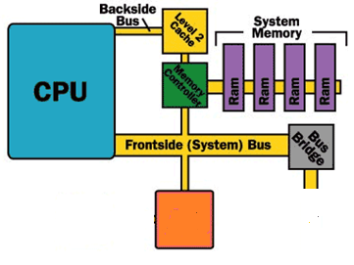
SDRAM – SYNCHRONOUS DYNAMIC RAM
DRAM which synchronous with system bus
Main reasons to use DRAM
Capacity and power consumption are more important factors than access speed
System or Frontside Bus
Parallel conductor lines which
connects CPU to other components
64-bit processor needs bus to be
64-bit wide, i.e. 1 bit of info per line
Other comp-onents
Comp-onents on other bus types

Slide 24
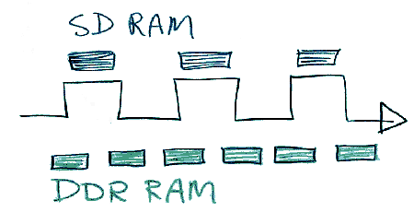
SDRAM – SYNCHRONOUS DYNAMIC RAM
Double Data Rate (DDR)
Data transfer at both the positive going and negative going transitions, hence double data rate
DDRn is DDR generation n
LPDDR is Lower Power DDR for mobile devices
GDDR is graphics DDR for
graphics card

Slide 25
COMPUTER GENERAL KNOWLEDGE QUIZ #3
When you download a new game on your mobile phone, where is the game stored?
(A) RAM, (B) Flash Memory, (C) Neither
When you are playing a game of Angry Bird, where does the CPU store the current states of the game, i.e. how many birds or pigs left?
Where does the CPU store the high score?
(A) RAM, (B) Flash Memory, (C) Neither

Slide 26
ARDUINO UNO COMPONENTS
Reset button
Digital I/O
USB Input
ATMega328 MCU
DC Input
ADC
Power & Auxiliary pins

Slide 27
OTHER COMPONENTS
General or Digital Input / Output pins
Total = 14
Digital signal has two states:
LOW (0)= 0 V
HIGH (1) = 5 V
Analog-to-Digital Converter (ADC) pins
Total = 6
To convert analog (continuous) signals into their digital equivalents
More in Lecture 3
Power Supply
Accept 6-20 VDC input, 7-12 VDC is recommended

Slide 28
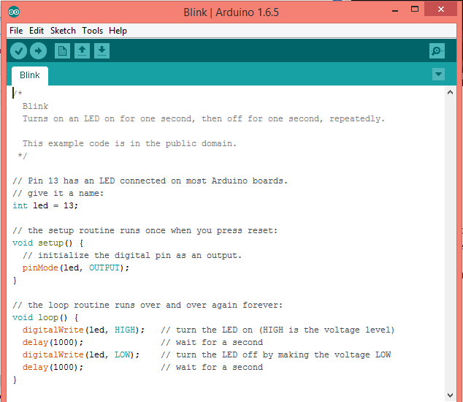
ARDUINO IDE (INTEGRATED DEVELOPMENT ENVIRONMENT)
Can be downloaded from
https://www.arduino.cc/en/Main/Software
Programming in C++ language

Slide 29
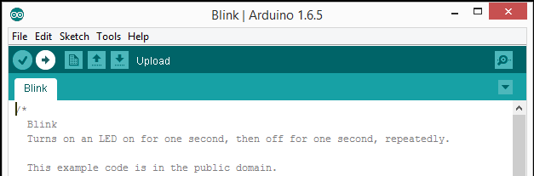
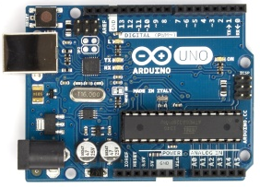
CONNECTING PC TO ARDUINO BOARD
Upload button
Clicking the Upload button shall upload the program to the Flash Memory of Arduino Uno
USB Input
USB Cable
USB port

Slide 30
BOOTLOADER PROGRAM
A program to “boot-up” or “bootstrap” the computer
For general purpose computer, it loads the operating system (Windows, iOS, Android, etc.) from hard drive or Flash memory to the RAM
For Arduino Uno, it does the following
Check for new programming command from IDE
If yes, start to download new programme from PC
If no, load latest programme stored in the Flash memory
The Arduino Uno Bootloader program is activated upon power up or reset

Slide 31
SUMMARY
Arduino Uno MCU Board
ATMega 328 MCU
Number of bits, processor speed
Memory: RAM, EEPROM, Flash Memory
Other components
Digital I/O pins, ADC pins, power supply
Programming Environment: Arduino IDE
Connecting PC to Arduino Board
Bootloader Program

